Slide 1
High-Assurance Cryptographic Hardware from Untrusted Components
By:
Ravi sankar gogineni

Slide 2
Contents
Background
Introduction
Preliminaries
Architecture
Secured Distributed Computations
Implementation
Optimization
Experiments
Conclusion

Slide 3
Background
The semiconductor industry is fully globalized and integrated circuits (ICs) are commonly defined, designed and fabricated in different premises across the world.
Despite extensive post-fabrication testing, it is not uncommon for ICs with subtle fabrication errors to make it into production systems.
Many critical systems with high security needs to rely on secure crypto processors to carry out sensitive security tasks (e.g., key generation and storage, legally binding digital signature, code signing) and provide a protection layer against cyber-attacks and security breaches.
In most cases, secure crypto processors come embedded into Hardware Security Modules, Trusted Platform Modules and Cryptographic Accelerators, which are assumed to be both secure and reliable.

Slide 4
Background(Continuation)
In several documented real-world cases, contained errors, backdoors or trojan horses.
Due to the severity of these threats, there is a large body of work on the mitigation of malicious circuitry. Existing works have pursued two different directions: detection and prevention.
To make matters worse, vendors that use commercial off-the-shelf (COTS) components are constrained to use only post-fabrication detection techniques, which further limits their mitigation toolchest.
For this reason, many error and backdoor detection techniques have been proposed over the years.

Slide 5
Introduction
This paper proposes Myst, a practical high-assurance architecture, that uses commercial off-the-shelf (COTS) hardware, and provides strong security guarantees, even in the presence of multiple malicious or faulty components.
Specifically, the paper has employed more than a hundred COTS secure crypto coprocessors, verified to Level 4 tamper-resistance standards, and use them to realize high-confidentiality random number generation, key derivation, public key decryption and signing.
Unlike N-variant systems, instead of replicating the computations on all processing units, Myst uses multi-party cryptographic schemes to distribute the secrets so that the components hold only shares of the secrets (and not the secrets themselves), at all times.
The proposed architecture is of particular interest for two distinct categories of hardware vendors:
Design houses that outsource the fabrication of their ICs.
On the other hand, COTS vendors that rely on commercial components to build their high-assurance hardware.

Slide 6
Preliminaries
1. Backdoor-Tolerant:
A Backdoor-Tolerant system is able to ensure the confidentiality of the secrets it stores, the integrity of its computations and its availability, against an adversary with defined capabilities.
2. Threat model:
We assume an adversary is able to incorporate errors (e.g., a hardware trojan) in some ICs but not all of them.
Malicious ICs aim to be as stealthy as possible, and conceal their presence as best as possible, while nonthreatening components may be hard to detect errors (e.g., intermittent faults) that cannot be trivially uncovered by post-fabrication tests.
Finally, we assume a software developer or device operator builds and signs the applications to be run on the ICs. From our point of view, they are trusted to provide high-integrity software without backdoors or other flaws.

Slide 7
Architecture
So, In this section we are going to introduce the Myst architecture which draws from fault-tolerant designs and N-variant systems
The proposed design is based on the thesis that given a diverse set of k ICs sourced from k untrusted suppliers, a trusted system can be build, as long as at least one of them is honest.
Alternatively, the architecture can tolerate up to 100% compromised or defective components, if not all of them collude with each other.

Slide 8
Architecture Diagram
An overview of the Myst’s distributed architecture, featuring all the integral components and communication buses.

Slide 9
Components in Architecture
There are 4 components in the architecture. The 4 components are:
1. Processing ICs:
The ICs form the core of Myst, as they are collectively entrusted to perform high-integrity computations and provide secure storage space.
2. IC controller:
The controller enables communication between the ICs and makes Myst accessible to the outside world.
Specifically, it enables:
Unicast, IC-to-IC
Broadcast, IC-to-ICs
Unicast, Host-to-IC
Broadcast, Host-to-ICs

Slide 10
Components in Architecture (Continued)
3. Operator:
The operator is responsible for setting up the system and configuring it.
The operator determines the size of the quorums and sets the security parameters of the cryptosystem.
4. Remote Host:
The remote host connects to Myst through the IC controller; it issues high level commands and retrieves the results.
In order, for the commands to be executed by the ICs, the host must provide proof of its authorization to issue commands, usually by signing them with a public key associated with the user’s identity
5. Communication channel:
At the physical level, the ICs, the controller, and the hosts are connected through buses and network interfaces.
Hence, all messages containing commands, as well as their eventual responses are routed to and from the ICs through untrusted buses.

Slide 11
.
Access Control Layer:
Access Control (AC) is critical for all systems operating on confidential data.
In Myst, AC determines which hosts can submit service requests to the system, and which quorums they can interact with.

Slide 12
Secured Distributed Computations
introduce a set of protocols that leverage the diversity of ICs in Myst to realize standard cryptographic operations manipulating sensitive keying material
Steps Involved
Distributed Key Pair Generation
Encryption
Decryption
Random Number Generation
Signing

Slide 13
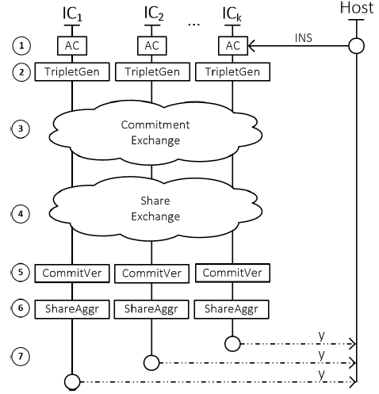
I. Distributed Key Pair Generation(DKPG)
Figure 1: The interaction between different participants during the Distributed Key Generation Protocol

Slide 14
Distributed Key Pair Generation (Cont...)
DKPG enables a quorum (set) of ICs to collectively generate a random secret x
1. The execution of the protocol is triggered when an authorized host sends an instruction.
2. Each member of the quorum runs algorithm 1 and generates a triplet pair
Algorithm 1: Triple Generation of pair and its commitment
Input : The domain parameters λ (Elliptical Curve Cryptography)
Output: A key triplet (x_{i} ,Y_{i} ,h_{i})
1. x_{i} = Rand(λ)
2. y_{i} = x_{i} . G
3. h_{i} = Hash(y_{i})
4. Return (x_{i},y_{i},h_{i})

Slide 15
Distributed Key Pair Generation (Cont...)
3. Once the triplets are generated, the members (ICs) perform a pair wise exchange of their commitments by which all ICs hold a set H = {h1, h2,h3..ht}
4. Another round of exhange starts for the share of Yagg. Now all ICs will have a set Y = {y1,y2,y3... yt}
5. The validity of Ys elements are verified against their commitments in H.
If the one or more commitments are failed then the protocol is terminated

Slide 16
Distributed Key Pair Generation (Cont...)
Algorithm 2: CommitVerify: Checks Yi , against their respective
commitments.
Input : (Y,H)
Output:Bool
for i ∈ {1, |Y |} do
if Hash(Y_{i} ) , h_{i} then
return False
return True
6. If all the commitments are successfully verified then the aggregate share of all ICs is caculated
7. The aggregate share is sent to the host.

Slide 17
II.Encryption
Algorithm 3: Encrypts a plaintext using the agreed common key
Input : The domain parameters T, Plaintext m encoded as an element of
the group G, the public key Y.
Output: The Elgamal ciphertext tuple (C1, C2)
1. r = Rand(T)
2. C₁ = r.G
3. C₂ = m + r.Y agg
4. return (C1, C2)

Slide 18
III. Decryption
Initially the host broadcasts the decryption instruction and part of the ciphertext to the processing ICs.
ICs verify that the request is signed by an authorized user.
Execute the algorithm to generate their decryption share Ai
Each decryption share is signed by ICs and encrypted and sent to host.
Upon receiving all the decryption shares, the host runs below algorithm to combine and retrive plaintext.
Algorithm: algorithm to combine and retrive plaintext
Input :A part of the Elgamal ciphertext (C₁) and the IC’s private key of xi
Output:The decryption share Ai , where i is the IC’s uid
A_{i} = −xi · C₁
Return A_{i}

Slide 19
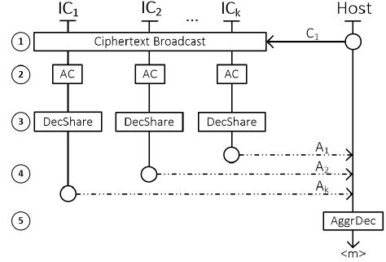
III Decryption (Cont...)

Slide 20
IV Random Number Generation
The remote host submits a request for randomness to all actors participating in the quorum.
Subsequently, each actor independently generates a random share, encrypts it with the public key of the host, and signs the ciphertext with its private key.
Once the host receives all the shares, it combines them and then uses an one way function to convert it to a fixed length string.

Slide 21
V Signing
Myst also supports distributed signing.
A multi-signature scheme allows a group of signers to distributively compute a signature on a common message

Slide 22
IMPLEMENTATION
1. HARDWARE DESIGN AND IMPLEMENTATION
2. SOFTWARE

Slide 23
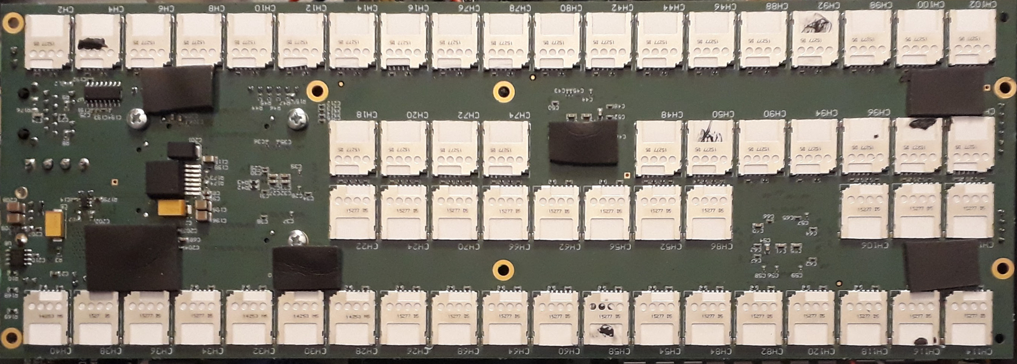
HARDWARE IMPLEMENTATION
1. SMART BOARD
Java Cards
Inter-operability
Tamper resistant
Cryptographic capabilities
Myst's Smartcard board supports 120 ICs ( 60 on each side).
The configuration splits them into 40 quorums of 3 diverse ICs each.

Slide 24
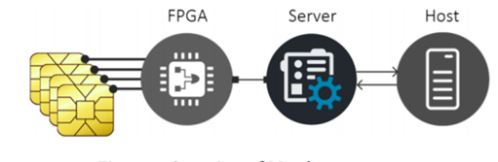
2. HOST AND SERVER
Host: computer that runs a python client which submits the user requests ( ie. Cipher text decryption) to Myst using a RESTful API.
The incoming requests are handled by a spring server which parses them and converts them to a sequence of low level instructions and then forward them to the IC controller through an 1 Gbps TCP/UDP interface.
3. IC CONTROLLER
The IC controller: Programmable Artix-7 FPGA that listens to incoming instructions and them routes them to the processing ICs.

Slide 25
SOFTWARE
The processing ICs are loaded with Java-card applets implementing methods for:
Card Management
Key Generation
Decryption
Signing

Slide 26
PROBLEM FACED?
JavaCard APIs provide BigNumber class which provides too small internal
type length which is typically atmost 8 bytes.

Slide 27
PROBLEM FACED?
JavaCard APIs provide BigNumber class which provides too small internal type length which is typically atmost 8 bytes.
Solution:
The only third party BigInteger library available is BigNat that can handle high level instructions.
Extended BigNat to provide methods for specific needs.

Slide 28
PROBLEM FACED?
The low-level elliptic curve operations are limitedly supported by standard Javacard API.

Slide 29
PROBLEM FACED?
The low-level elliptic curve operations are limitedly supported by standard Javacard API.
Solution:
Developed own EC operations library based on public Javacard API to support ICs that provides methods for EC point initialization, negation, addition, subtraction and scalar multiplication.

Slide 30
OPTIMIZATIONS:
Pre-allocate all cryptographic engines and key objects during the applet installation. No further allocation during the rest of the applet lifetime is performed.
Hardware accelerated cryptographic methods from JavaCard API instead of custom implementations where possible.
Use of copy-free methods which minimize the move of data in memory, and also utilize native methods provided by JCSystem class for array manipulation like memory set, copy and erase.

Slide 31
SYSTEM STATES
NON-OPERATIONAL: The processing ICs do not respond to user requests. To make it operational, a secure initialization process has to be carried out.
INITIALIZATION: The processing ICs and the other components are loaded with verified application packages, and the domain parameters for the distributed protocols are set.
OPERATIONAL: Once the initialization process has been completed, the system switches to an operational state and is available to serve user requests.

Slide 32
EVALUATION EXPERIMENTAL SETUP:
Host: CentOS 7 OS, python client application.
Server: Spring Framework
IC Controller: Artix 7 FPGA

Slide 33
1. PERMORMANCE INPUT
METHODOLOGY:
In order to understand the overhead that the use of a distributed architecture entails, they run experiments that measure the latency as the size of the protocol quorum grows. We first submit 1,000 requests for each cryptosystem operation in one javaCard and measure the response time. We then extend the experiment to larger quorums with sizes ranging from 2 to 10, and measure the latency in completing the same 1,000 operations

Slide 34
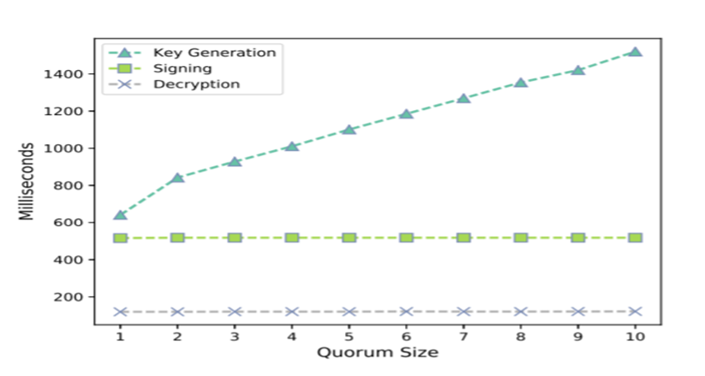
1. PERMORMANCE INPUT
RESULTS:
The average response time for each distributed operation of the cryptosystem, in relation to the quorum (i.e., a coalition of multiple ICs) size

Slide 35
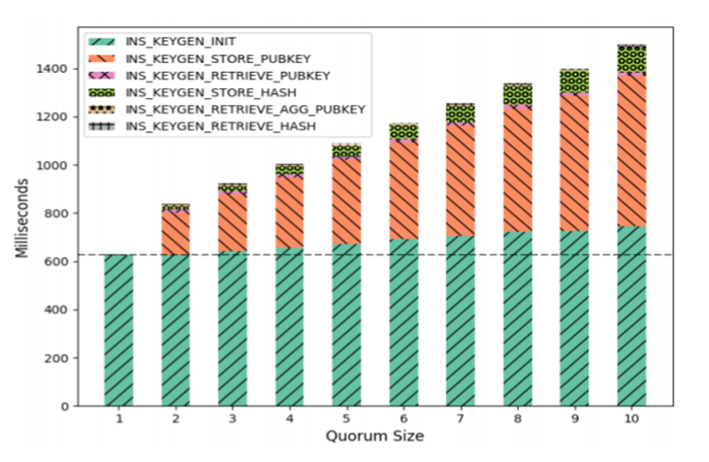
Breakdown of the runtime for low-level instructions that comprise the key generation operation, in relation to the quorum size. The horizontal reference line represent the cost of using a single IC.

Slide 36
2. SCALABILITY AND EXTENSIBILITY
METHODOLOGY:
To determine how efficiently our design scales in practice, we run a series of experiments that measure Myst’s throughput, for varying numbers of processing quorums. On each iteration of the experiment, 10,000 requests are submitted for each operation supported and throughput is measured.
This time,the number of quorums serving request simultaneously is fixed to 3, and on each iteration the number of quorums serving the submitted requests is increased by one, until we involve 40 quorums, which is the maximum number of 3-IC quorums that the prototype can support.

Slide 37
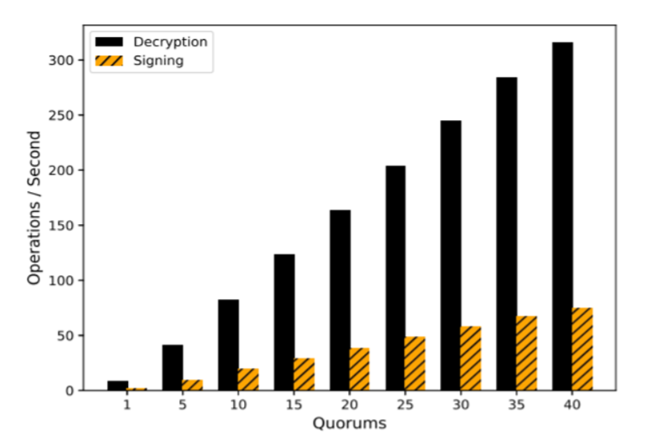
The average system throughput in relation to the number of quorums (k = 3) that serve requests simultaneously. The higher is better.

Slide 38
OTHER CONSIDERATIONS
Physical Security and Diversity: Smartcards forms the core of our prototype and have multiple benefits. They are very-high tamper resistance and secure storage capabilities, that are constantly evolving.
There are numerous independent facilities used by different vendors fabricate their ICs[30, 64, 80, 85], which also contributes to the necessary diversity for the quorums.
Real-world Practicality: Myst provides a platform for generating legally binding digital signatures ( eIDAS) under the sole control of the user. Also, due to tamper resistance properties of SmartCards, ICs can also be stored remotely.

Slide 39
CONCLUSION
Previous line of work is not tolerant to hardware errors and even one compromised component is enough to breach the security of the whole system.
In order to resolve this, Myst architecture has been introduced which distributes secrets and cryptographic computations among multiple, diverse integrated circuits.
Consequently, an adversary aiming to breach the confidentiality or integrity of the system much be able to compromise all the ICs. This is not a trivial task when ICs are manufactured from different vendors, in different premises.
To Evaluate Myst, a custom board featuring 120 smart cards are used which is controlled by artix-7 FPGA. The maximum throughput decryption is 315 ops/sec while for signing is 77 ops/sec. Both come with a reasonable computational overhead of less than < 1%.
Results: Myst is highly scalable, and provides strong guarantees for the security of the system making it suitable for production.

Slide 40
References
https://www.researchgate.net/publication/319662453_A_Touch_of_Evil_High-Assurance_Cryptographic_Hardware_from_Untrusted_Components/link/5d66b0e6458515b5b42086b5/download
https://backdoortolerance.org/ (YouTube video)

